Slide 1



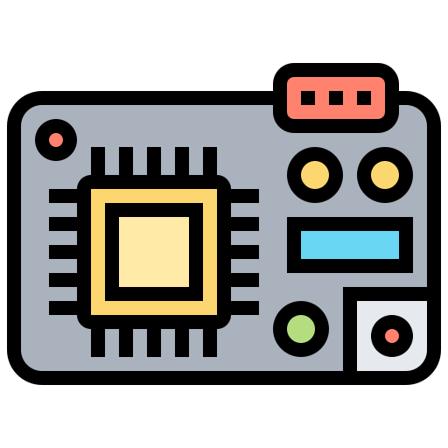
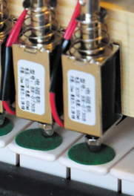

EECS 373
Robotic Piano Player
Pranav Narayanan, Daniel Moon, Zo-Vic Shong, Jesus Vidal Sanchez
{pranavn, danymoon, zovic, jesusvs}@umich.edu
MUSIC AND TECHNOLOGY COME TOGETHER TO EMULATE HUMAN PERFORMANCE SKILLS
LCD screen allows the user to select which song will be played by the system.
Uses a graphic library to display the interface
Features a touchscreen so that the user can interact with the system
Communicates with the STM through SPI
MIDI information is split into the respective two hands and proceeds through a complex algorithm to find the optimum times to move, and the ideal positions to play notes
Entire system is controlled by timer interrupts which manage priorities and ordering of note playing
The PC decodes information from locally stored MIDI files using Python
It's Beginning To Look A Lot Like Christmas….
Python Script
SPI
Arm Cortex M3
UART
Electromechanical
Belt Linear Actuator
two hands
(3D printed structure)
Linear Actuators
The Electromechanical Belt is used to move the hands horizontally in order to reach different note registers.
We are using two belts, one for each hand so that they can move independently from each other. Each belt is moved by a Stepper Motor, connected to a Stepper Controller that makes them run at 2.8A of current.
They are powered by a power source.
DAC
DC actuators are used to emulate human fingers:
12 dc actuators attached to each one of the two hands allow for triggering notes individually.
The STM controls the voltage needed to trigger each actuator
GPIO expanders needed to be used. They connect the actuators to the STM and use I2C protocol for communication.
Speaker
Due to the fact that some notes cannot be reached by our design, we implemented an external speaker.
We will play notes out of range through the speaker instead of hitting keys
It generates a sine wave to the corresponding frequency of the note intended to be played. The input to the speaker is the STM´s DAC.

